Slide 1

ITIL 4 Foundation Exam Study Guide
Your targeted revision guide based on exam performance analysis. This comprehensive study resource focuses intensively on your weakest areas while reinforcing stronger topics to ensure exam success.

Slide 2


Your Exam Performance Analysis
40%
67%
Service Management Concepts
ITIL Guiding Principles
Critical foundation area needing focused attention
Good progress but room for improvement
0%
29%
Four Dimensions
15 ITIL Practices
Priority area requiring immediate focus
Major knowledge gap to address
This analysis shows where to concentrate your study efforts. The four dimensions and ITIL practices require immediate attention, while service management concepts need substantial reinforcement.

Slide 3
Priority Study Areas
Four Dimensions of Service Management
15 ITIL Practices (Key Terms)
Service Management Concepts
Your Score: 28.57%
Your Score: 0%
Significant knowledge gaps. Focus on purpose and terminology for each practice.
Your Score: 40%
Complete foundation rebuild needed. This is your highest priority topic with maximum impact potential.
Foundation concepts need strengthening. Critical for understanding all other topics.

Slide 4








The Four Dimensions of Service Management
The four dimensions ensure a holistic approach to service management. Every service and practice must consider all four dimensions to deliver value effectively. Think of them as essential perspectives that must be balanced.
Organizations and People
Information and Technology
Culture, roles, competencies, and organizational structure required for service delivery
Technology infrastructure, data, and information systems supporting services
Value Streams and Processes
Partners and Suppliers
How activities are coordinated and integrated to create value
External relationships, contracts, and third-party dependencies

Slide 5

Key Service Management Concepts
Understanding these fundamental concepts is essential for ITIL success. These definitions form the foundation of everything else in the framework.
Service
1
A means of enabling value co-creation by facilitating outcomes that customers want to achieve, without the customer having to manage specific costs and risks.
Value
2
The perceived benefits, usefulness, and importance of something. Value is always defined by the customer or stakeholder receiving the service.
Outcome
3
A result for a stakeholder enabled by one or more outputs. Outcomes represent what the customer actually wants to achieve.
Utility and Warranty
4
Utility is what the service does (fitness for purpose). Warranty is how well it performs (fitness for use). Both are required for value.

Slide 6

The ITIL Service Value System (SVS)
Guiding Principles
Universal recommendations for decisions
Service Value Chain
Governance
Transforms demand into value
Oversight to ensure alignment and compliance
Continual Improvement
Ongoing enhancement of services and practices
The SVS describes how all components and activities of an organization work together to enable value creation. It's the operating model that integrates guiding principles, governance, service value chain, practices, and continual improvement.
01
02
03
Opportunity/Demand
Service Value Chain
Value
External inputs that trigger the value creation process
Six interconnected activities that transform inputs into outputs
Outcomes, benefits, and value delivered to stakeholders

Slide 7




Service Value Chain Activities
These six activities are interconnected and can be combined in various ways to create different value streams. Understanding how they work together is crucial for the exam.
Plan
Ensure shared understanding of vision, current status, and direction
Design & Transition
Ensure products and services meet stakeholder expectations
Deliver & Support
Ensure services are delivered and supported to agreed specifications
Improve
Engage
Ensure continual improvement of products, services, and practices
Provide good understanding of stakeholder needs and transparency
Obtain/Build
Ensure service components are available when needed

Slide 8
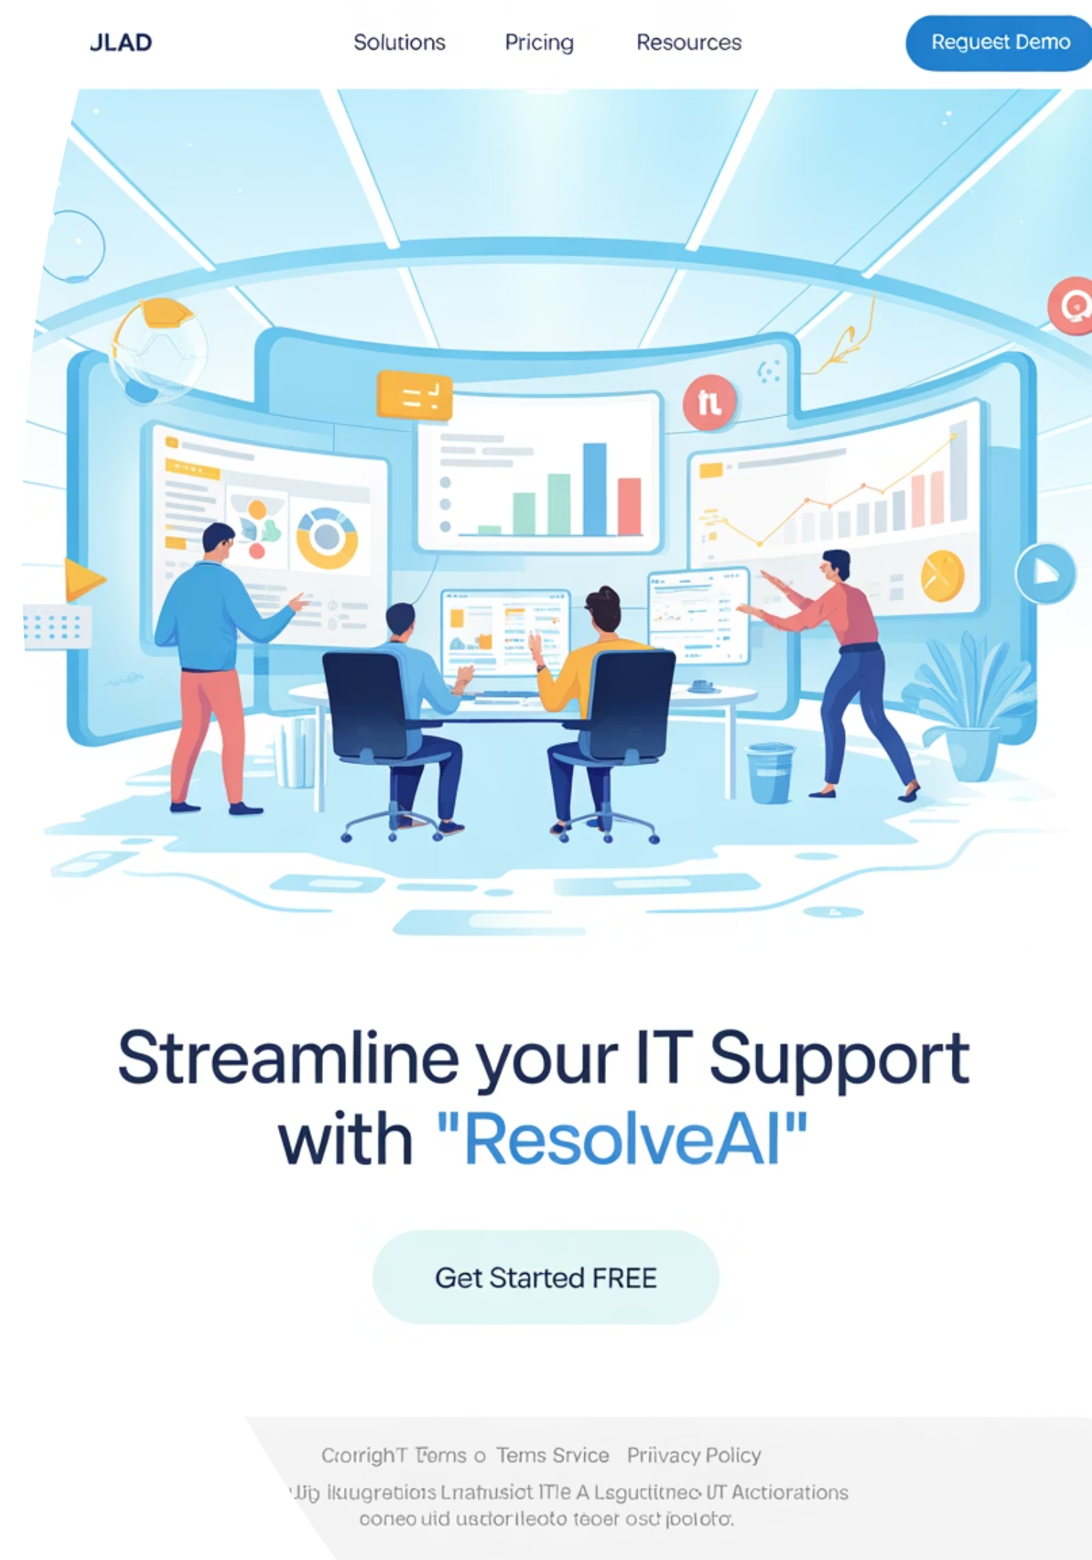
Critical ITIL Practices - Part 1
These practices scored lowest in your assessment. Focus on understanding their purpose and key terms for each practice.
Incident Management
Problem Management
Purpose: Minimize negative impact of incidents by restoring normal service operation as quickly as possible.
Purpose: Reduce likelihood and impact of incidents by identifying actual and potential causes and managing workarounds and known errors.
Key Terms: Incident, Major incident, Incident model, Workaround
Key Terms: Problem, Known error, Error control, Problem model
Change Management
Purpose: Maximize number of successful service and product changes by ensuring risks are properly assessed and changes are authorized.
Key Terms: Change, Change authority, Change model, Emergency change

Slide 9



Critical ITIL Practices - Part 2
Service Desk
Service Configuration Management
Release Management
Purpose: Capture demand for incident resolution and service requests, and provide a single point of contact.
Purpose: Make new and changed services and features available for use.
Purpose: Ensure accurate and reliable information about configuration items and their relationships is available.
Key Terms: Release, Release model, Release package, Deployment
Key Terms: Service desk, Self-service, Service request fulfillment
Key Terms: Configuration item (CI), Configuration management system (CMS), Baseline

Slide 10

Additional Key ITIL Practices
Service Level Management
1
Set clear business-based targets for service performance and ensure delivery against these targets is properly measured and managed
2
Availability Management
Ensure services deliver agreed levels of availability to meet current and future needs of the organization
Capacity and Performance Management
3
Ensure services achieve agreed and expected performance levels, satisfying current and future demand
4
IT Service Continuity Management
Ensure availability and performance of services to required levels in case of a disaster

Slide 11












ITIL Guiding Principles
These seven principles guide organizations in all circumstances, regardless of changes in goals, strategies, or work methods. You scored 67% - good foundation but room for improvement.
Focus on Value
Start Where You Are
Everything must link back to value for stakeholders
Don't start over without considering what's already available
Keep It Simple and Practical
Progress Iteratively with Feedback
Use minimum number of steps to accomplish objectives
Resist attempting everything at once
Think and Work Holistically
Collaborate and Promote Visibility
No service stands alone - consider the bigger picture
Work together across boundaries for better results

Slide 12









Exam Strategy: Question Types
Understanding question formats will improve your exam performance. The ITIL 4 Foundation exam contains 40 multiple-choice questions in 60 minutes.
Definition Questions
Scenario Questions
Test your knowledge of key terms and concepts. Focus on precise ITIL definitions, not general IT knowledge.
Apply ITIL concepts to real situations. Read carefully and identify which principle or practice applies.
List Questions
Purpose Questions
Identify components, activities, or characteristics. Know the seven guiding principles and six value chain activities.
Know the specific purpose of each practice. Don't confuse similar practices like incident and problem management.

Slide 13
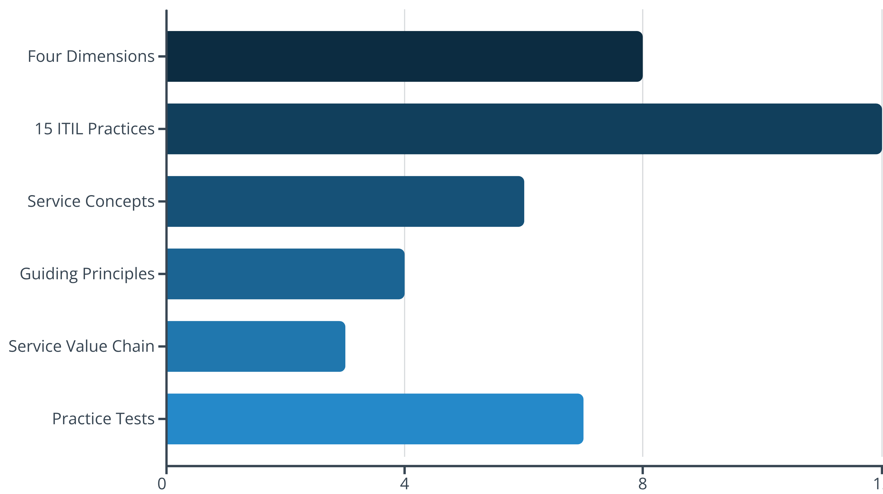
Study Schedule Recommendations
Based on your performance analysis, allocate more time to your weakest areas. The four dimensions and 15 ITIL practices should receive the most attention. Regular practice tests will help identify remaining knowledge gaps.

Slide 14


Final Exam Tips
1
Read Questions Carefully
Look for key words like "primary purpose," "best example," or "main benefit." These guide you to the correct answer.
2
Use Process of Elimination
Eliminate obviously wrong answers first. Often you can narrow down to two choices, improving your odds significantly.
3
Watch Your Time
You have 90 seconds per question. Don't spend too long on difficult questions - mark them and return later.
4
Trust Your ITIL Knowledge
Choose the answer that best reflects ITIL principles, not general common sense or previous IT experience.
Pass Mark: You need 65% (26 out of 40 questions) to pass. Focus your remaining study time on the areas identified in this guide.

Slide 15

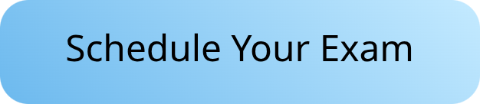

You're Ready for Success!
40
60
65%
Questions
Minutes
Pass Rate
Multiple choice format
Total exam time
26 correct answers needed
You now have a targeted study plan based on your specific knowledge gaps. Focus intensively on the four dimensions of service management and the 15 ITIL practices, as these represent your greatest opportunity for score improvement.
Remember: consistent, focused study of your weak areas will yield the best results. Use this guide as your roadmap to ITIL 4 Foundation certification success. You've got this!

